Slide 1

Group Handbook
Department of Chemistry
Hong Kong University of Science and Technology

Slide 2
Contents
Pre – Arrival Checklist
After Arrival and Academic Resources in HKUST
Daily Life in HKUST
Daily Life in HK

Slide 3
1. Pre-Arrival Checklist
Click here to go through the full text.
The points are also listed here , for your reminder.
Apply for Student Visa | Important, see following slide 1.1
Note Important Dates and Events | Check your email frequently.
Arrange for Insurance | Just pay it together with the tuition fee.
Arrange for Accommodation | Important, see following slide 1.2
Activate ITSC Network Account | Important, see following slide 1.3
Prepare for Arrival in HK | Important, see following slide 1.4
Complete Program Registration | Important, see following slide 1.5
Register for ELPA Speaking Test | Register it according to the email.
Register for the Welcome Reception | Register it according to the email.

Slide 4
1.1 Apply for Student Visa
Don’t Panic
Check emails frequently. If anything happens, contact HKUST.
Click here to get the full instructions.
Accept the Offer
Log in to the HKUST Visa System
Send Visa Application to HKUST
HKUST Submits Your Application to IMMD
Receive the Visa Label (sent by HKUST)
Activate the Visa Label upon Entry to HK.

Slide 5
1.1 Apply for Student Visa
Samples of Student Visa Label

Slide 6

1.2 Arrange for Accommodation
Guaranteed university accommodation will be given in the first 2 years of your full-time research postgraduate studies at HKUST.
The accommodation in HKUST is quite nice!
Click here to go through the application procedures, information of accommodation, and the check-in procedures.
Application Time for year 2018/19 For your reference.
Don’t miss it!

Slide 7
1.2 Arrange for Accommodation
Photos from SHRL website

Slide 8
1.3 Activate ITSC Network Account
Very Important since you will use ITSC account for many things during your stay in HKUST.
Procedures are simple:
Check your student ID number on the online admission system
Use your student ID number and HKID card number / date of birth to activate (you will get this link through emails)
Done! Then do not forget to activate your HKUST email as well.

Slide 9
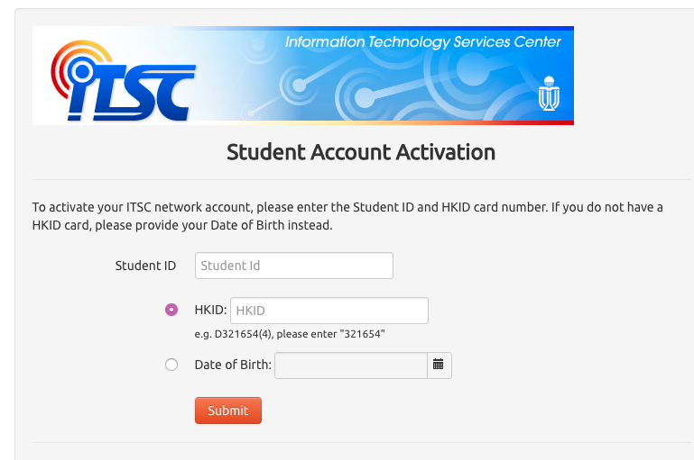
1.3 Activate ITSC Network Account
Application Number | A series of 11 numbers Only useful during application period. | 12345678910
Student ID number | A series of 8 numbers | 20596666
ITSC network account | A series of letters (3-12 characters) One letter for your first name + your last name + two random letters | ywangaa
ITSC email | <ITSC account>@connect.ust.hk | ywangaa@connect.ust.hk

Slide 10
1.4 Prepare for Arrival in HK
Don’t miss out the program registration, ELPA test and orientation events. Confirm the accommodation check-in date and come!
Packing List
Click here for the full lists
Documents
Passport/EEP, student VISA, offer letter, …
Funds
Take some cash to survive the time without local bank cards
Other Personal Belongings and Items
Take care of the weather, adaptors, …
From HK airport to HKUST
Options | Estimated Time | Estimated Cost
Red taxi (Hong Kong International Airport -> HKUST) | 45 mins | 360 HK$
Airport Express (Hong Kong International Airport -> Kowloon Station) + Red taxi (Kowloon Station -> HKUST) | 25+30 =55 mins | 105+220 =325HK$
Bus Number A29 (Hong Kong International Airport -> Po Lam) + Taxi (Red or Green) or Bus Number 91M（Po Lam -> HKUST) | 100+15 =115mins | 42+65 =107 HK$

Slide 11
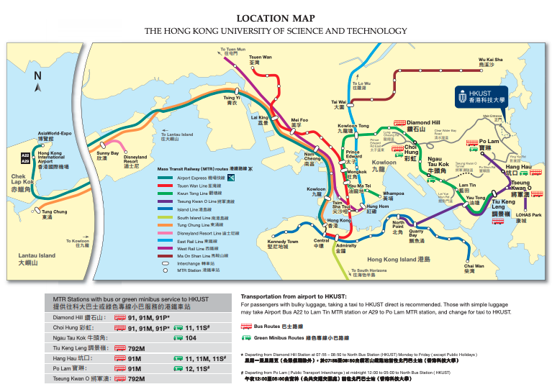
1.4 Prepare for Arrival in HK
Click here to download the map

Slide 12
1.5 Complete Program Registration
After sending the required documents to HKUST (normally transcripts), you will receive an email notification inviting you to register on your program of study.
The sample email has been put in the next slide.
What you need to do before that
Check the date and make sure you flight schedule is suitable.
Activate your ITSC account (see 1.3 for details)
Complete the Online registration form and upload your photo
If you don’t do that, you are required to take a photo on the day you register.
It’s worthy to prepare a nice photo!

Slide 13
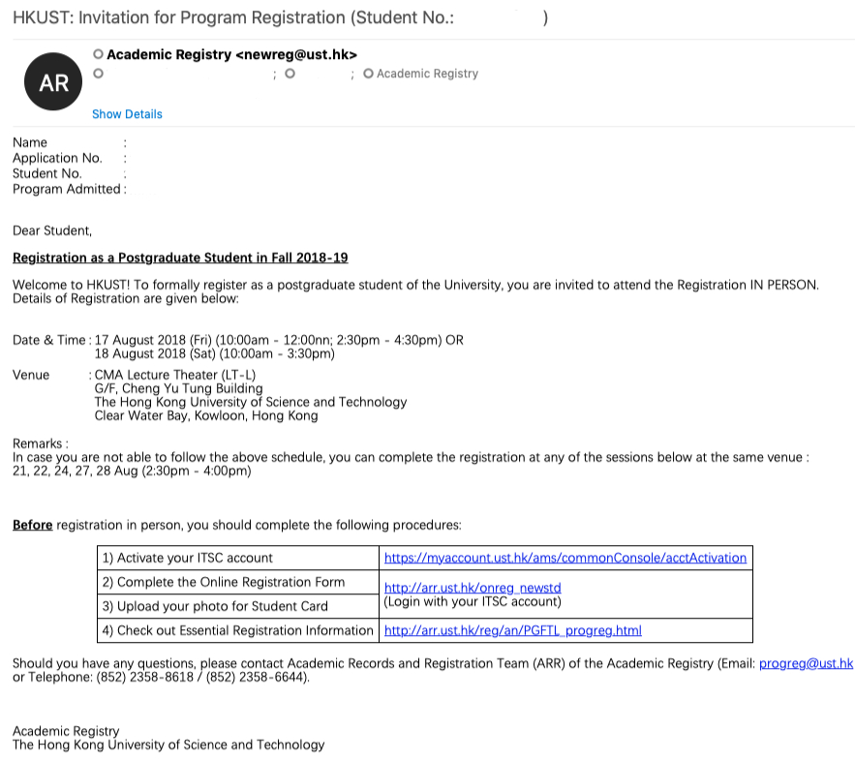
1.5 Complete Program Registration

Slide 14
2. After Arrival and
Academic Resources in HKUST
2.1 Course Registration
2.2 Campus Map
2.3 Library Services
2.4 Center for Language Education
2.5 Computer Barns
2.6 HPC2 Account
2.7 Software License

Slide 15
2.1 Course Registration
Step 1 | Check the curriculum requirement of CHEM
 | Check the courses offered by CHEM or other department
 | Check the suggested pattern by CHEM (see the figure in the next page)
 | Check the class schedule
Step 2 | Determine what courses you are going to choose
Step 3 | Check the enrollment schedule through student center website (see the figure in the next page)
Step 4 | Add the courses to “Shopping cart” and enroll the courses through student center website

Slide 16
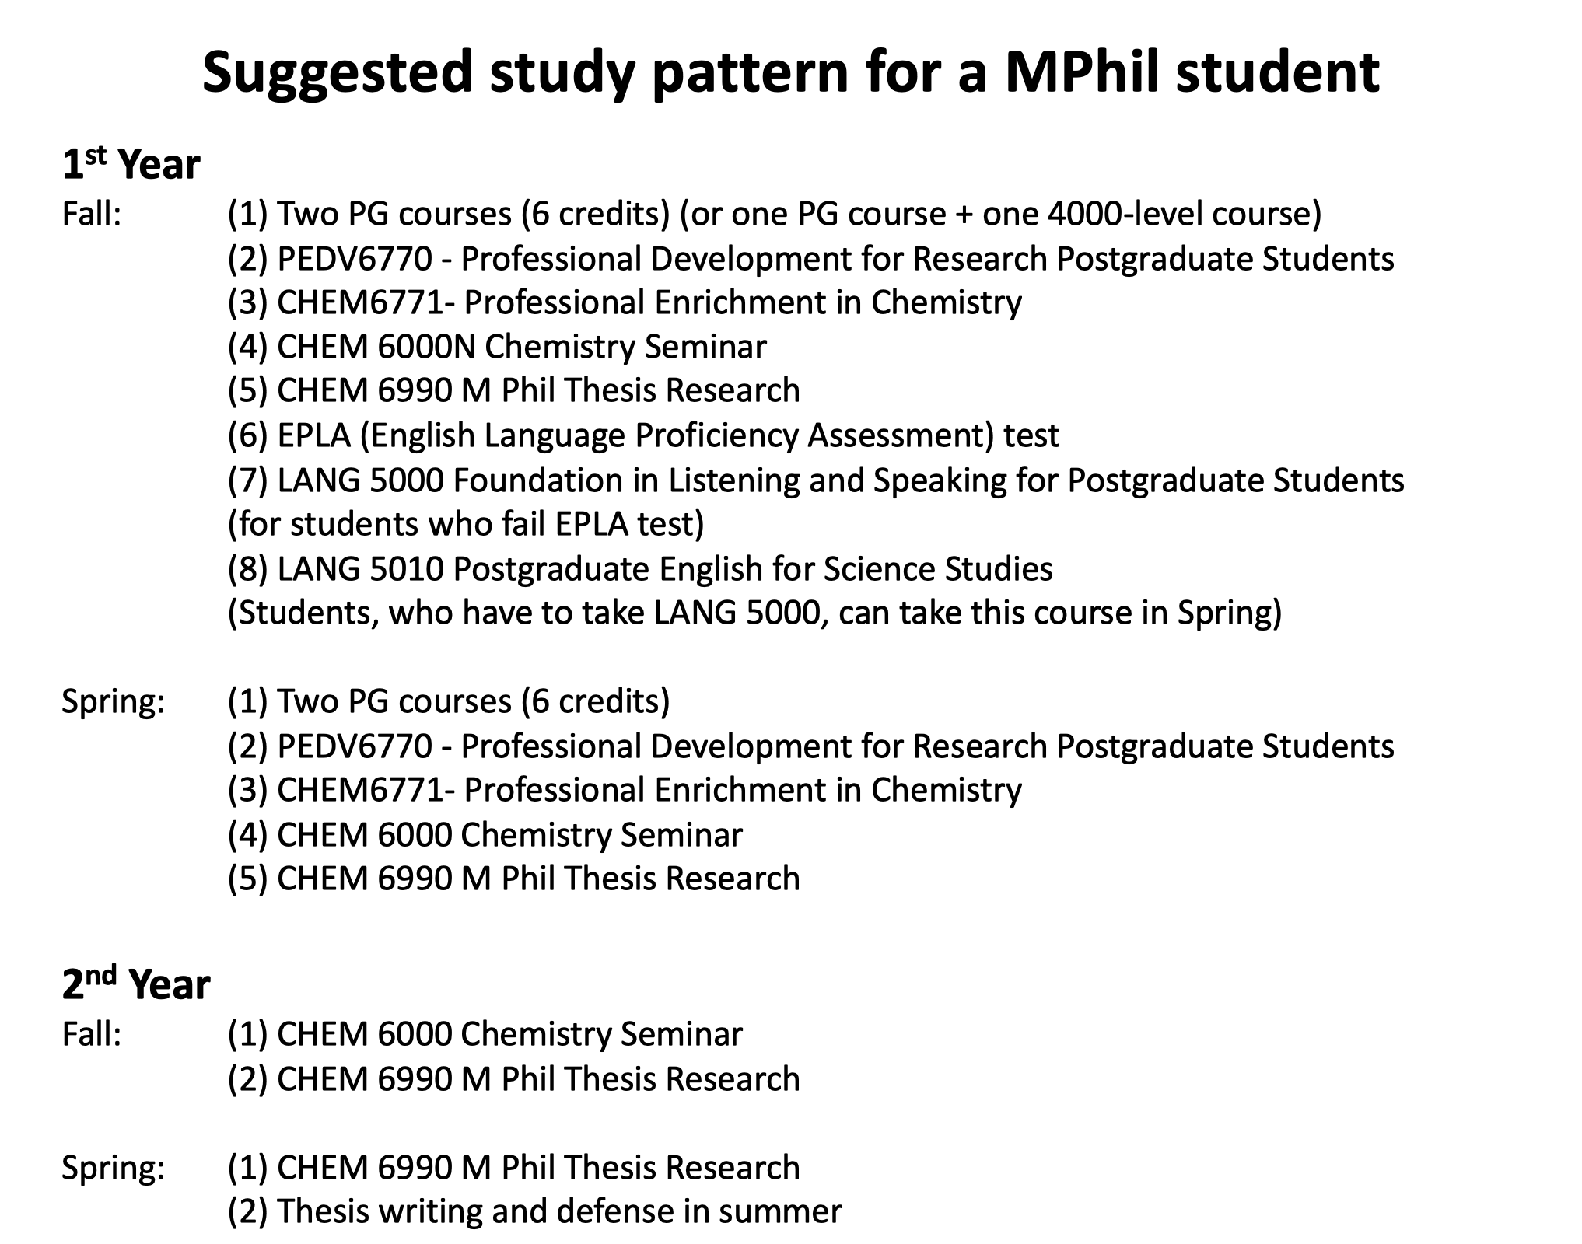
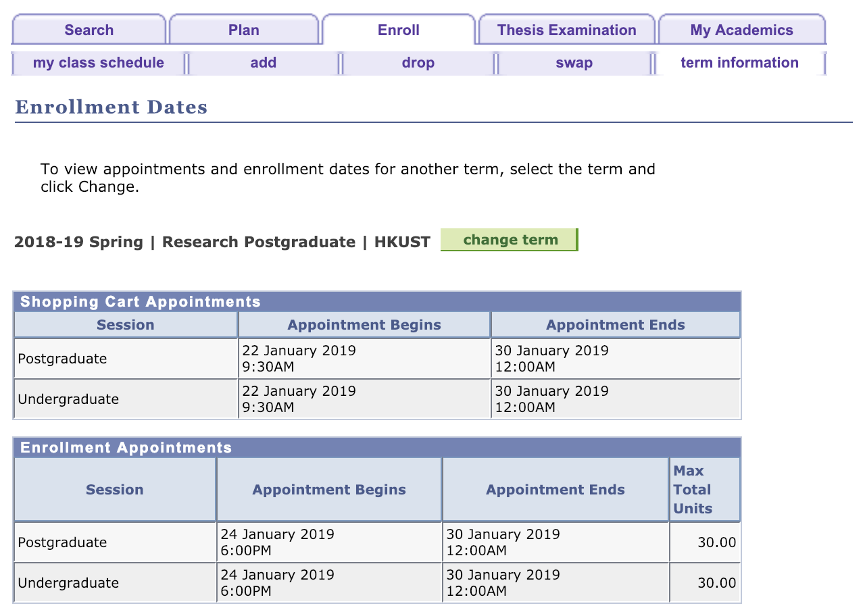
2.1 Course Registration
Suggested study pattern for a MPhil Student
(Click the link in the last page to see the whole PowerPoint)
Enrollment Dates (login the student center website )

Slide 17
2.2 Campus Map
Click here | Online version
Click here | Pdf version
Click here | Pdf version (focus on the lifts) | Recommended See the figure in the following page
Click here | Pdf version (focus on the theaters)
Click here | Path advisor | Recommended

Slide 18
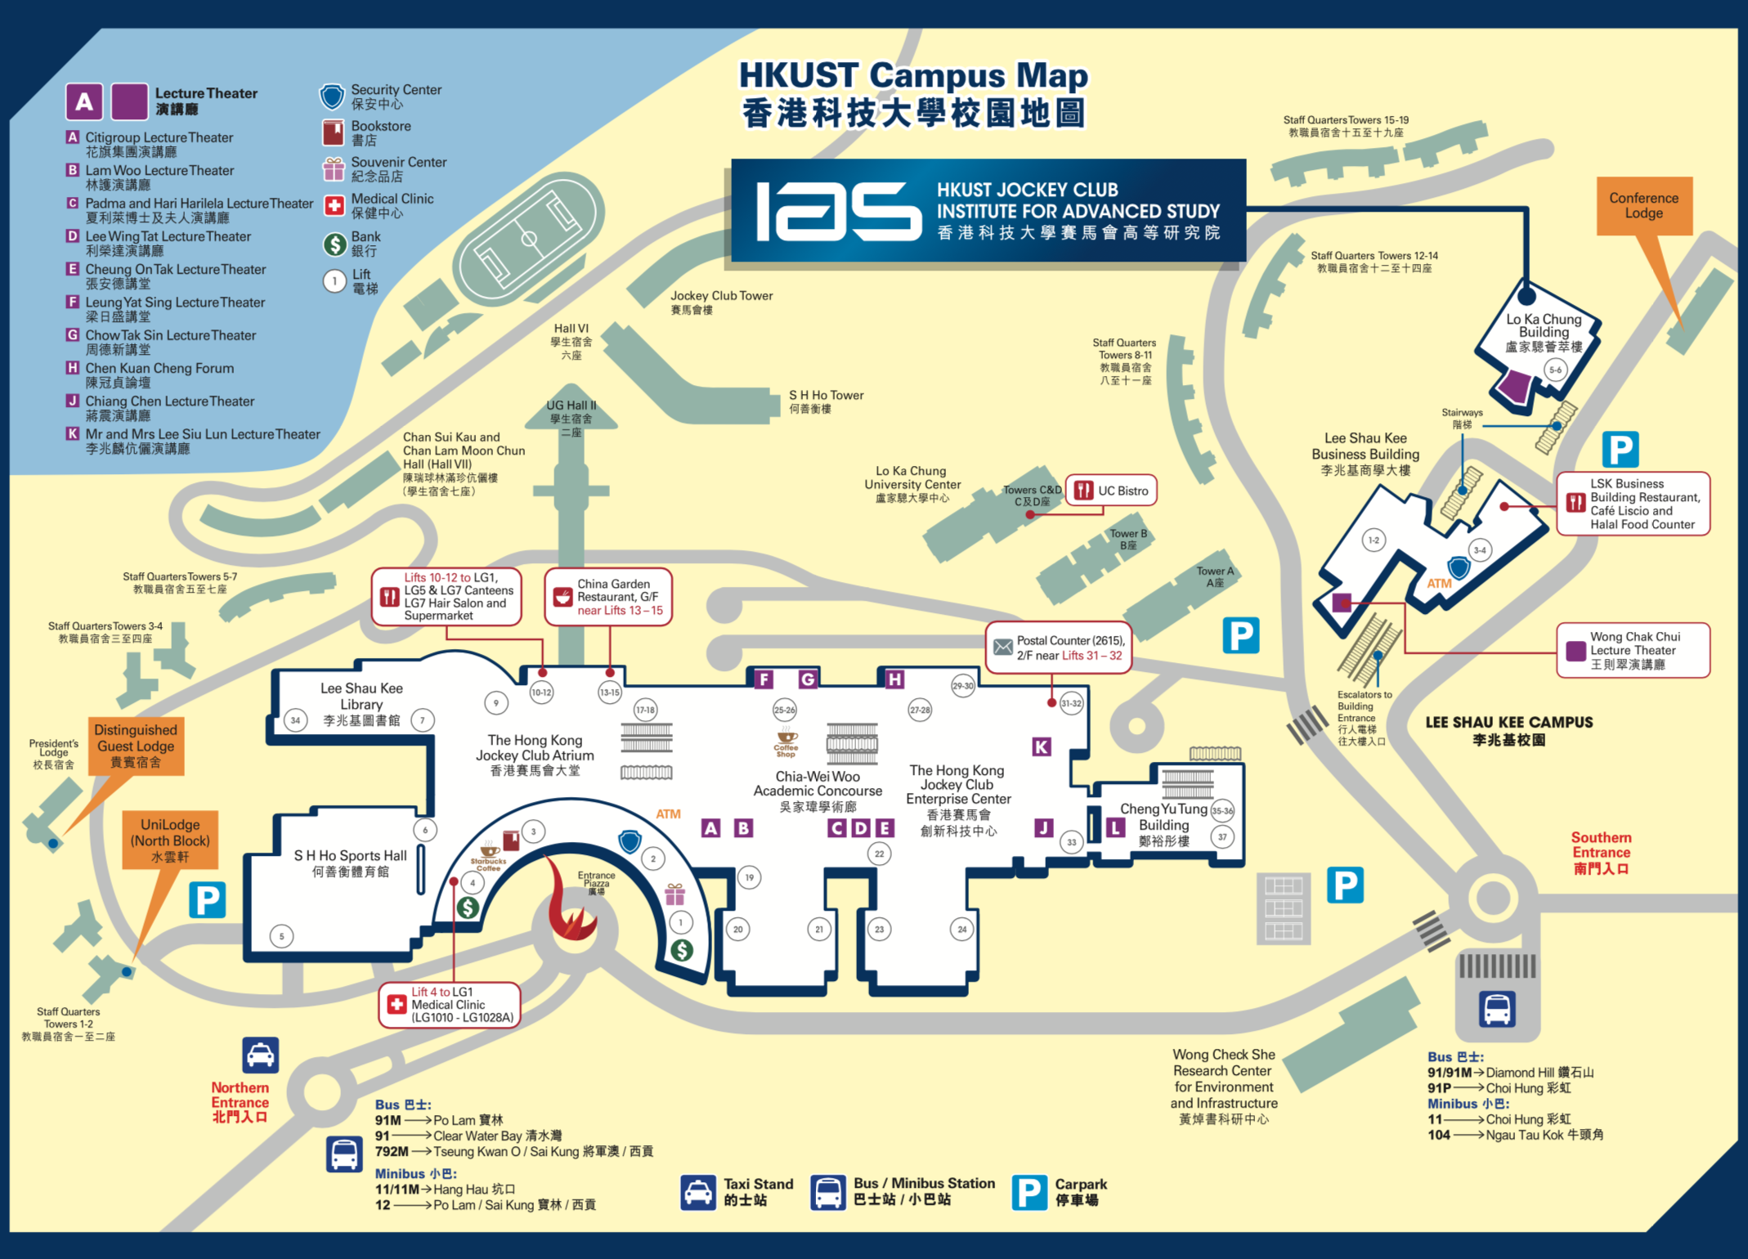
2.2 Campus Map

Slide 19
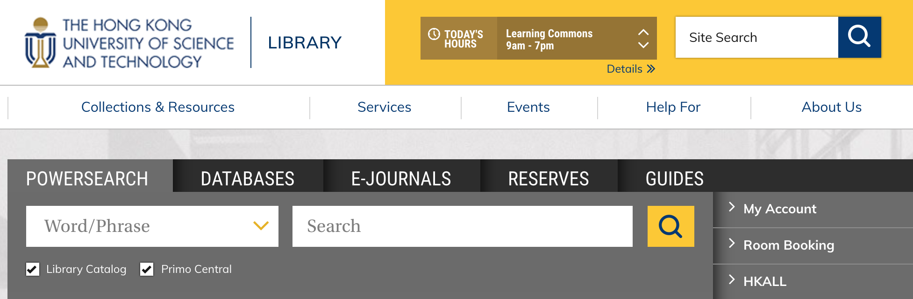
2.3 Library Services
Library Homepage
Library Floor Plan
To book group study rooms, media & discussion rooms, computers and etc. (See the figure in the following page)
To get the exact open time (learning commons and main entrance)
To search the materials you need

Slide 20
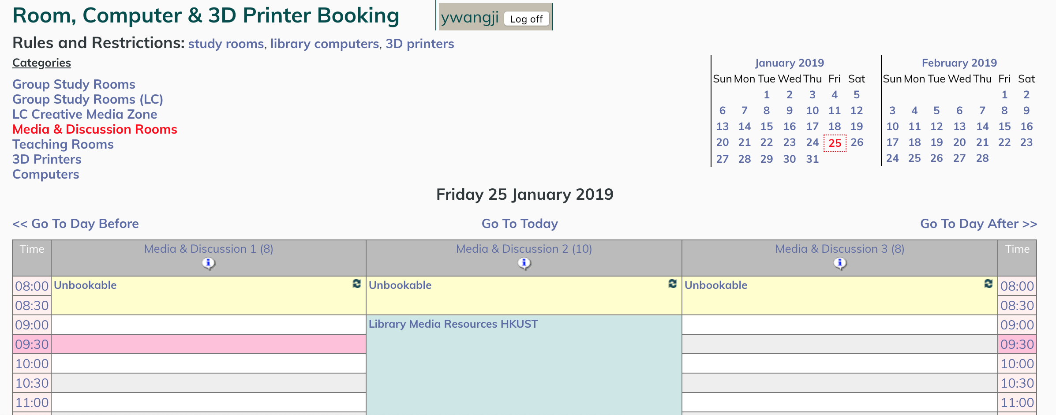
2.3 Library Services
Room, Computer & 3D Printer Booking

Slide 21
2.4 Center for Language Education
FORMAL LANGUAGE CURRICULUM | LANGUAGES | SERVICES
Chinese Curriculum Chinese Credit Transfer Chinese Placement Interview English Curriculum Proficiency test (ELPA) Mater of Arts in International Language Education (MAILE) | Arabic Chinese English French German Japanese Korean Latin Russian Spanish | Advising on Pronunciation Advising on Speaking Advising on Writing Chit-Chat Corner for English Facilities booking HKUST Toastmasters Club Putonghua Proficiency Test The Canto-Corner The Informal Curriculum for Language Learning (iLANG) The Putonghua Corner The Use of The Language Commons
ENGLISH LEARNING RESOURCES | CHINESE LEARNING RESOURCES | For UG For PG For UG + PG For UG + PG + Staff See full description at https://cle.ust.hk/
Listening Reading Speaking Vocabulary Writing | Listening Reading Speaking Vocabulary Writing

Slide 22
2.5 Computer Barns
ITSC runs four computer laboratories in different parts of the campus for members of the University community:
Computer Barn A: Room 4402-4404 (Lift 17-18)
Equipped with PCs, printers and scanners for both teaching and individual use
Computer Barn B Tang Shiu Kin Computational Laboratory: Room 1101 (Lift 17-18)
Equipped with PCs, printers and scanners for individual use, also equipment for students with special education needs (SEN)
Computer Barn C: Room 4578-4580 (Lift 27-28)
Equipped with PCs, printers and scanners for both teaching and individual use
Virtual Barn: Apart from going to the above computer barns, you can also access computer barn software and satellite printers anywhere anytime by connecting to virtual barn desktops from your own notebook/tablet and mobile phone

Slide 23
2.6 HPC2 Account
The HPC2 cluster is set up as an in-house high performance computing (HPC) facility at HKUST in Sep 2016. It has 92 compute nodes which are infiniBand (IB) connected at 56 Gbit/s and 960 TB raw disk storage. The total number of CPU and GPU cores is 2248 and 69888 respectively and the theoretical peak performance is 120 TFLOPS.
Account Application
HPC2 general information

Slide 24
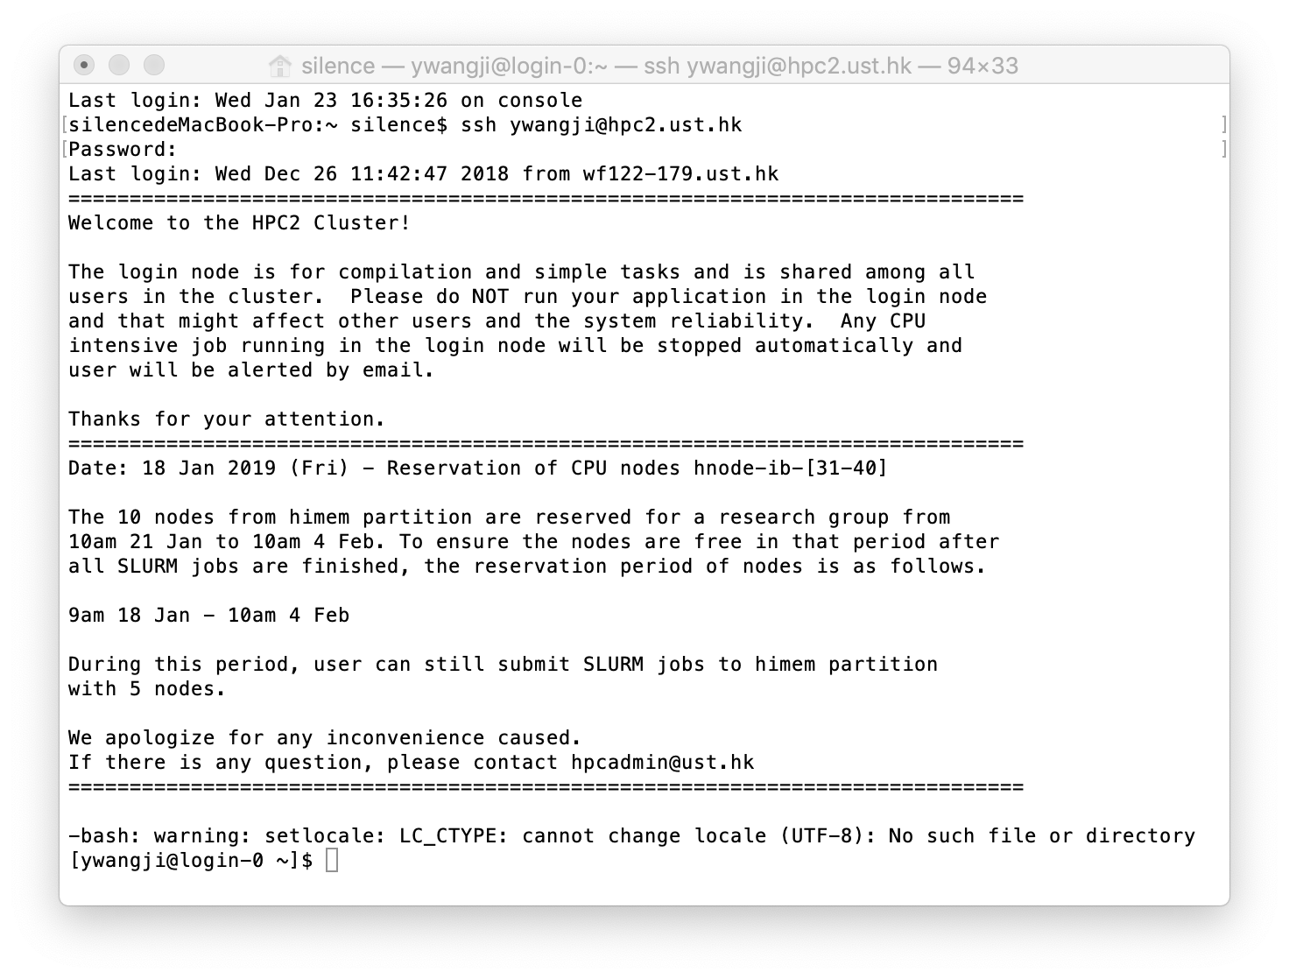
2.6 HPC2 Account

Slide 25



2.7 Software License
ITSC provides a wide range of software, mostly free of charge, for Staff and/or Students use, ranging from general desktop applications like Microsoft Office, to specialized academic software. These software are pre-installed in offices/ lab areas for use, or are available for individuals to download.
Click the website
Click the button “Application Setup Advisor”
Click the button “Get Advice”
Remember to “declare” to access for more software
Click the button “Get Advice” again

Slide 26
3. Daily Life in HKUST
3.1 Catering
3.2 Sports
3.3 Shops
3.4 Online shopping
3.5 Other things
3.6 Useful Links
3.7 Useful APPs

Slide 27
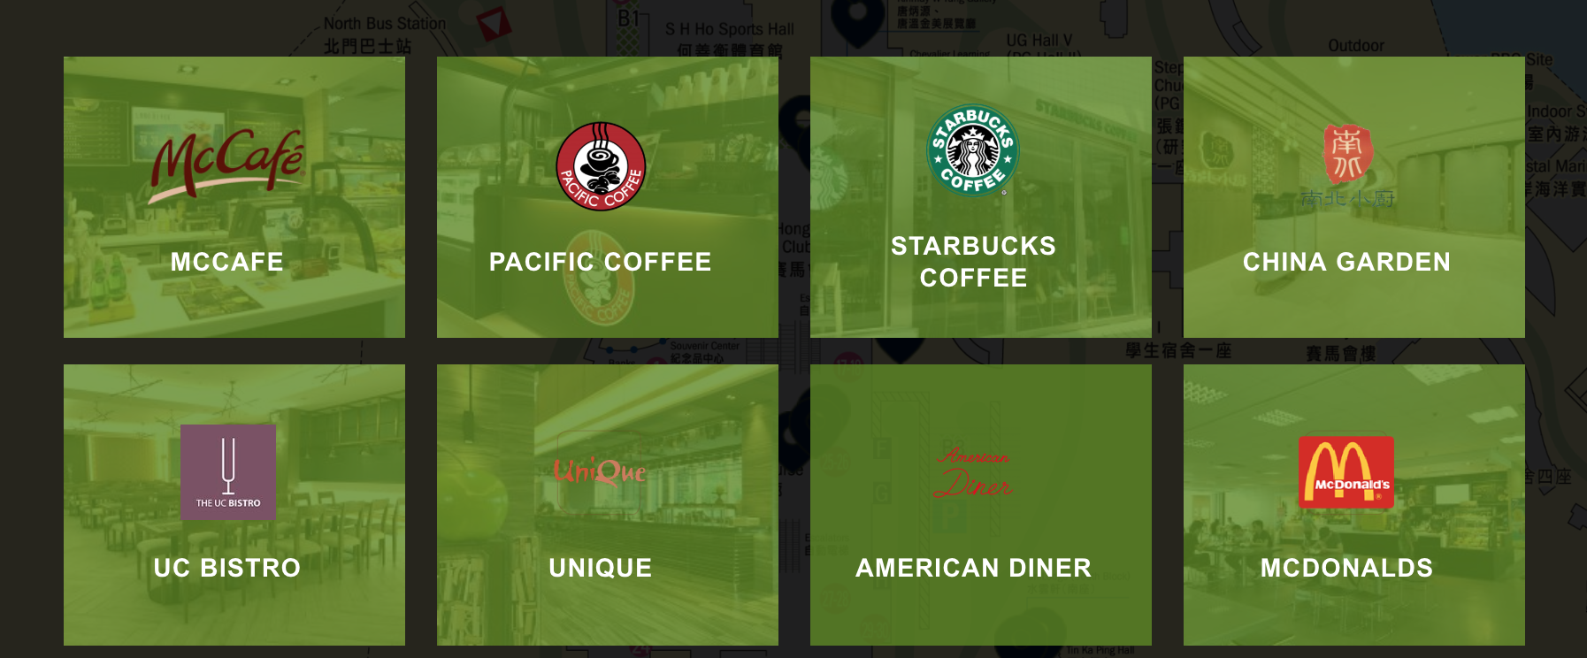
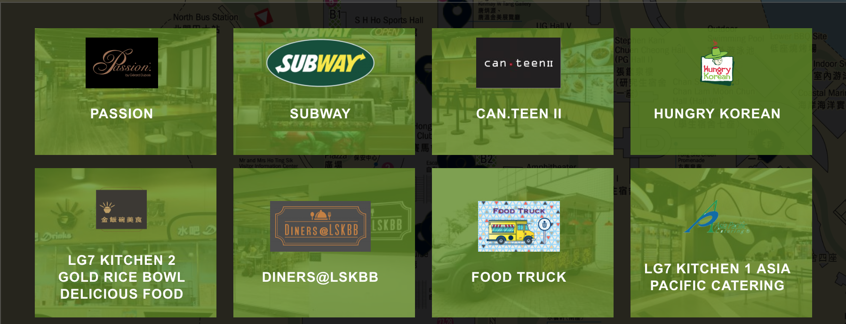

3.1 Catering
Click here for full lists

Slide 28

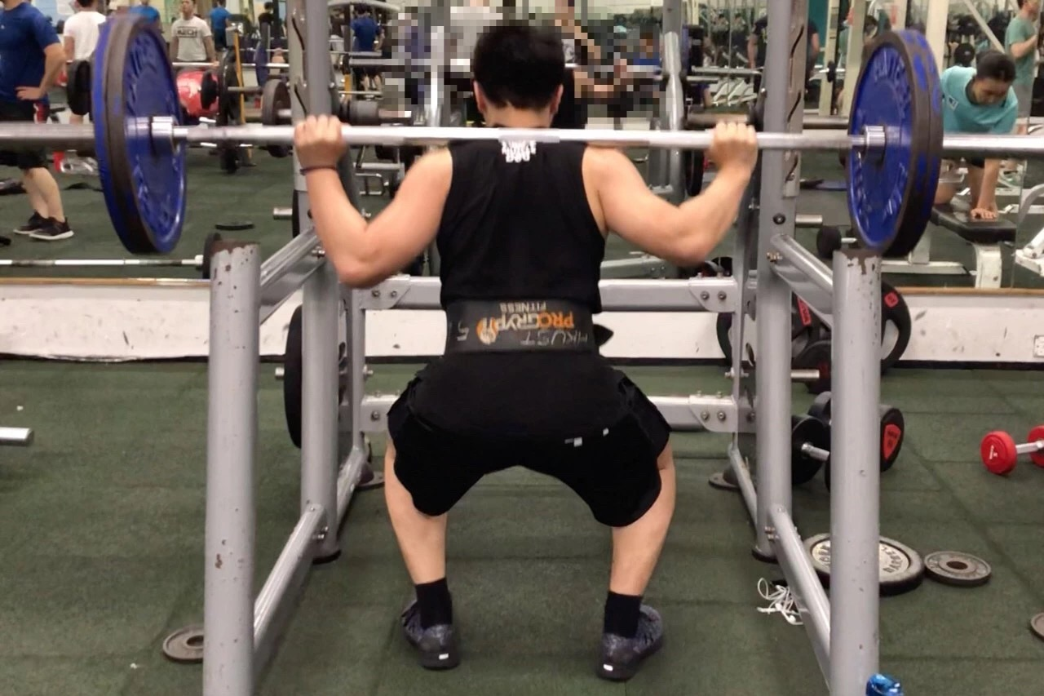
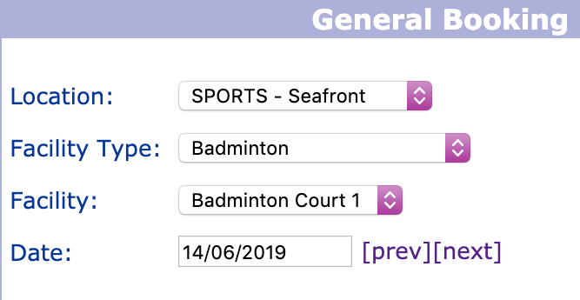
3.2 Sports
Sports clubs
Fitness center (no need to book)
Booking for sports facilities
Note: There are many badminton fans in Rm 4207 :(

Slide 29
3.3 Shops
Bookstore | Supermarket | Hair Salon
The Commercial Press (HK) Ltd | Fusion | Mega Hair
G/F, near Lift 3 | LG7, near Lift 10-12 | LG1, near Lift 4
Monday - Saturday: 09:00 - 18:00 Sunday & Public Holiday: Closed | Sunday - Friday: 08:30 - 24:00 Saturday & Public Holiday: 08:30 - 21:00 | Monday - Friday: 10:30 - 19:00 Saturday: 10:30 - 18:30 Sunday: 11:00 - 17:00 Public Holiday: Closed
HKUST students/staff/alumni can enjoy the following discount (excluding cyber bookshop & magazines, periodicals & certain publications) - Campus Bookstore: 10 - 22% - Off-Campus shops: 10 - 15% | HKUST students/staff can enjoy 5% discount for most of the goods | Price lists

Slide 30
3.4 Online shopping
Through eBay or Taobao HK, you can do online shopping and receive your stuff in HK
If your products can not be directly delivered to HK, you need a transport service
Register your account in shadow or piaoliuHK, then you will get a default address in Shenzhen.
Fill in this address when you make online order, then Taobao store send your products here.
Starting Point
Shenzhen
Shadow
HKUST
near lift 19 G/F
PiaoliuHK
Taobao official
Then, pay the money for transport service (Shenzhen to HK). You may want to wait for many products from different stores, and then package them together for delivering which will save money.

Slide 31
3.5 Other things
 |  | Name | Location | Opening Hours
 | Student | Student Dental Clinic | Room LG1010 -LG1028A LG 1 (lift 4) | Mon – Fri: 9:00 - 12:30 & 13:30 - 16:45 Sat: 9:00 - 11:45 Sun & PH: Closed
Staff |  | Medical Clinic
 |  | Staff Dental Clinic
Clinics
Location | Room 2615 (2/F, lift 31-32)
Operating Hours | 09:00 - 12:30; 14:00 - 17:15
Postal Counter
Post Service
Outside CMA Lecture Theater (LT-L)
Outside Leung Yat Sing Lecture Theater (LT-F)
Post Boxes

Slide 32
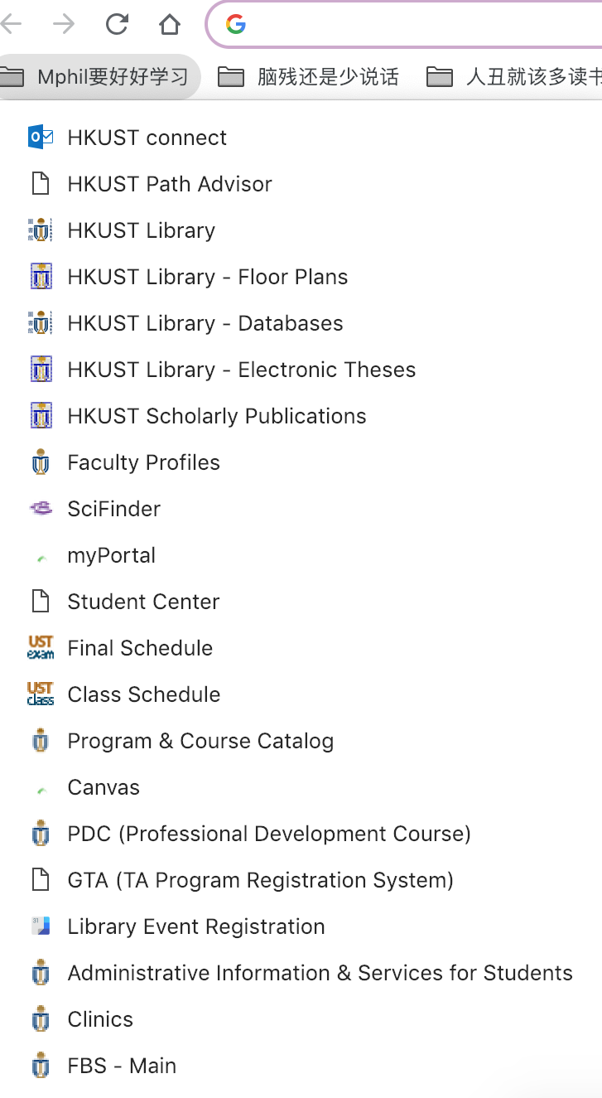
3.6 Useful Links
The most important is myPortal(my.ust.hk) since you can get many other links through it. (See the figure in the following page)
You may also want to build a bookmark like the right figure. Here I list some links:
HKUST Path Advisor
HKUST Library
HKUST Library – Floor Plans
HKUST Library – Databases
HKUST Library – Electronic Theses
HKUST Scholarly Publications
Faculty Profiles
Final Schedule
Class Schedule
Program & Course Catalog
Administrative Information & Services for Students
Clinics
FBS – Main

Slide 33
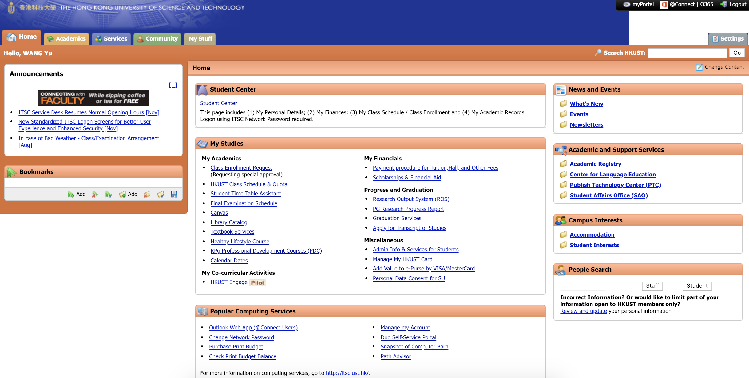
3.6 Useful Links
From myPortal, you can find links to hkust connect, student center, canvas, PDC and so on

Slide 34
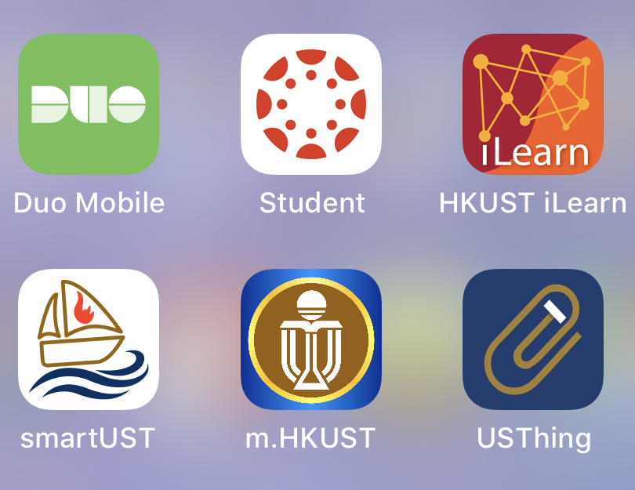
3.7 Useful APPs
iPRS
Enables you to quickly respond to questions or pulls created by your instructor in class.
2FA validation
Canvas
Can check some information of HKUST
Can check seminars, exhibition and so on every weeks
Can book sports facility rooms

Slide 35
4. Daily Life in HK
4.1 Hiking
4.2 Rent a house
4.3 Public Transport
4.4 Hospitals

Slide 36
4.1 Hiking
There are many mountains and hiking paths in HK. Click below two links for full lists.
Oasistrek 绿洲
HK hike 远足香港
Sai Kung is near HKUST, which is beautiful and worth exploring.
HKUST is here

Slide 37

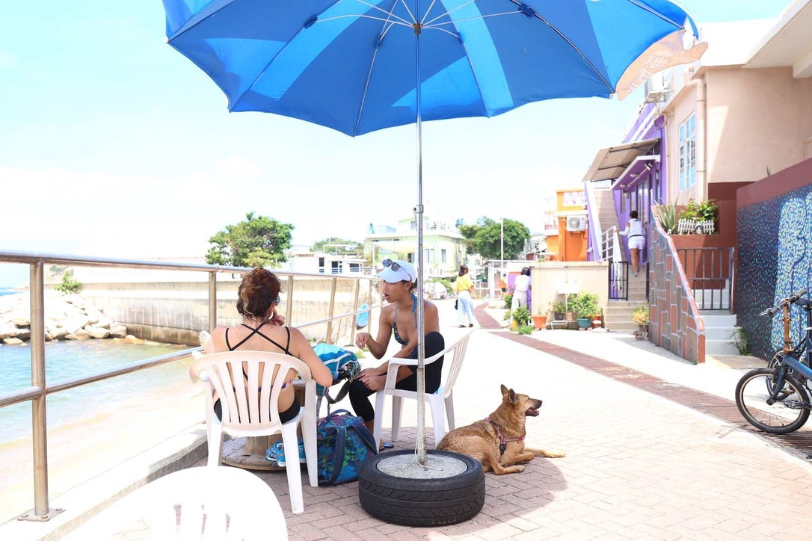

4.1 Hiking
石澳 Shek O
蚺蛇尖 Sharp Peak
飞鹅山 Kowloon Peak

Slide 38
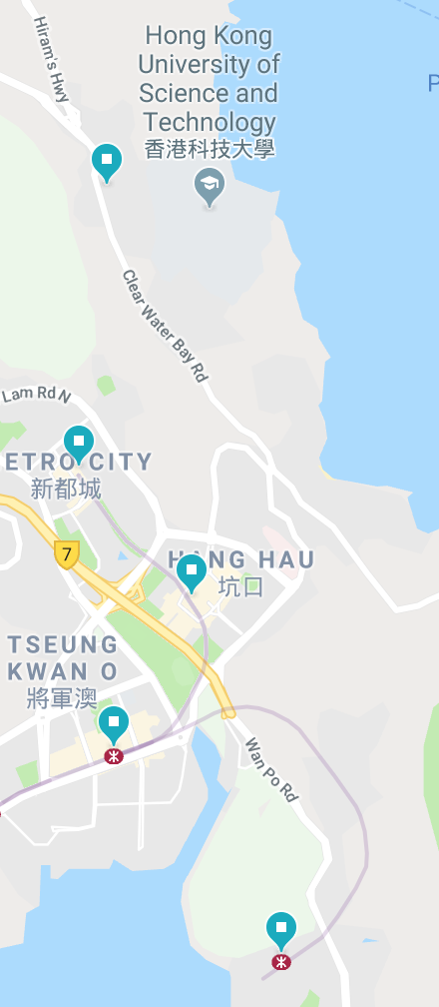
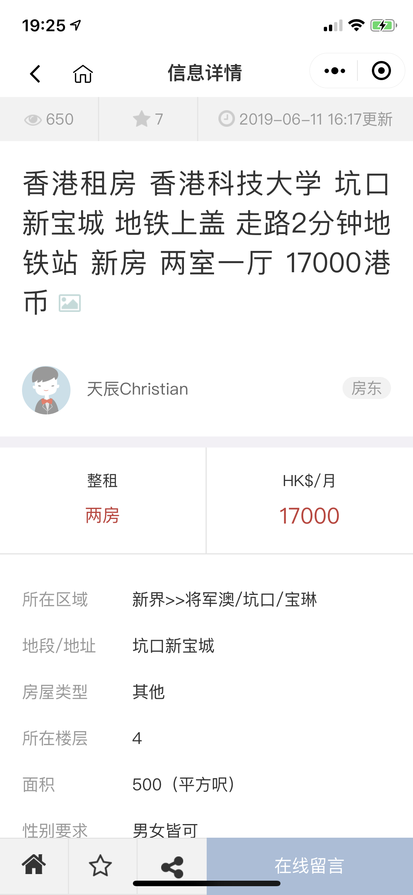
4.2 Rent a house
Click this for the recommendation
Channels
Get support from HKUST
Online forum
WeChat group
WeChat Mini Programs “寄托香港租房”
大埔仔
Tai Po Tsai
宝琳
Po Lam
坑口
Hang Hau
将军澳
Tseung kwan O
康城
Lohas Park

Slide 39
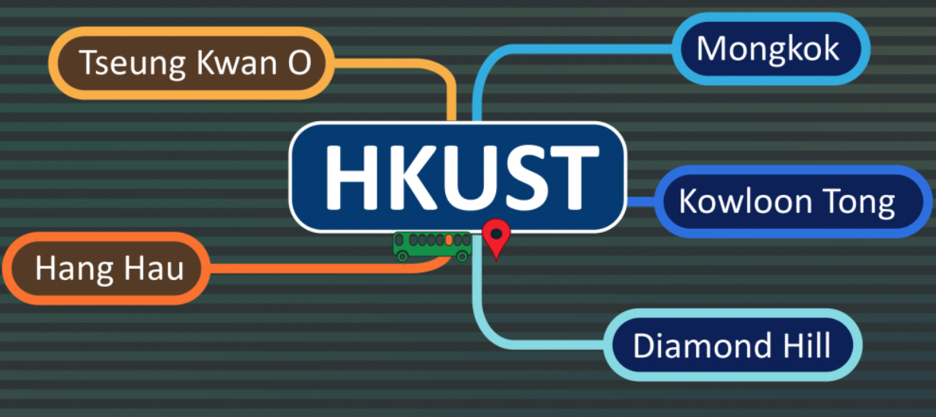
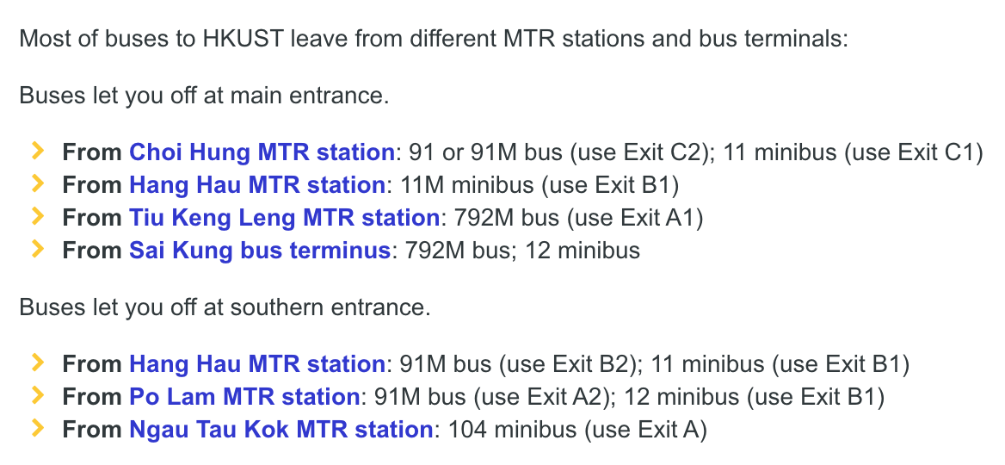
4.3 Public Transport
Click public transport introduction from HK government
Shuttle bus service for HKUST
Public bus and mini-bus around HKUST

Slide 40
4.4 Hospitals
For small case, you can just go to HKUST clinic (free and convenient).
For big case, you may also want to go to HKUST clinic first (to get an initial diagnosis, then go to hospital as doctor suggests).
For urgent case (HKUST clinic has no 24-hour emergency department), you may need to go to hospital.
Generally
Public Hospitals : cheap but need
to wait for a long time
Private Hospitals : expensive
The nearest hospital near HKUST
Tseung Kwan O Hospital
Distribution of Clusters, Hospitals & Institutions

Slide 41
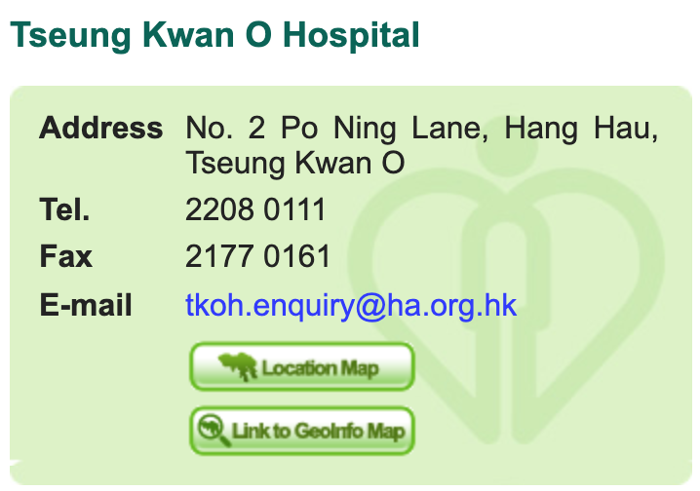
4.4 Hospitals
Public
See full list here
Even for emergency case, you need to wait for several hours.
Make sure you take you HKID card.
For those without HKID card, the cost is more expensive.
Private
See full list here

